Slide 1
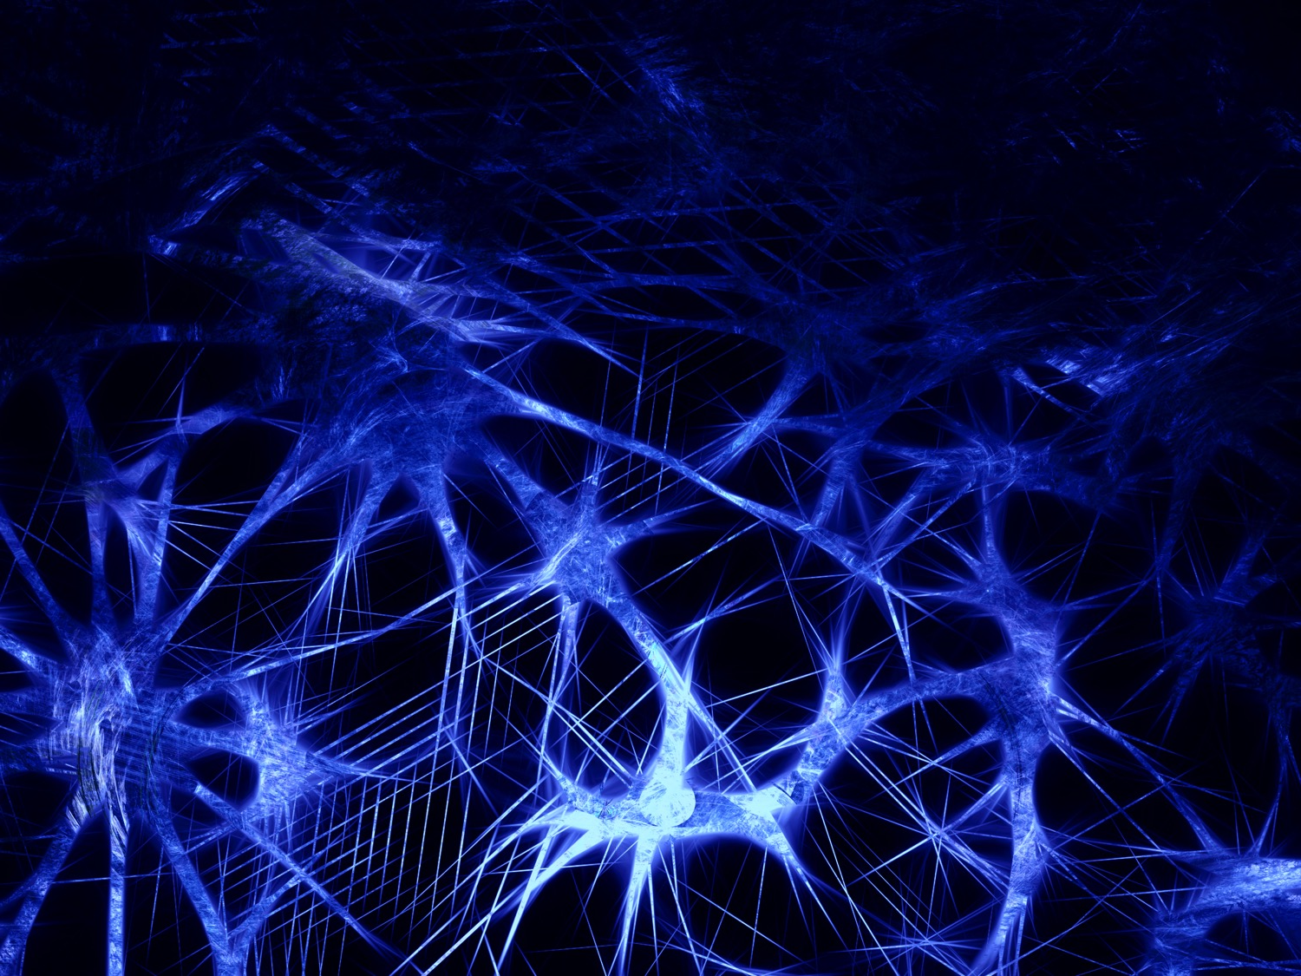
Deep Learning Neural Networks What they are, what they can do, and what they cannot do
James V Stone, University of Sheffield
Notes:
Title: Nature’s Neural Currency: Energy or Information?
The currency of neurons
Is Information the Language of Neurons?
Neural Information Theory:
Is Neural Coding Efficient?
Efficiency and Neural Information Theory
The Efficient Coding Hypothesis Predicts Inefficient Neurons
SAY: Nothing in biology makes sense except in the light of evolution.
ASK: What is the main driver? Information per Joule?
KIT = mex hat, wine glass,
Main point: key properties efficient coding hypothesis.
In any system there is one main driver (Taylor expansion).
Barlow (1961)
Not just how, but why. Indeed not even how, but why.
Plan: do colour in detail and skim rest.
Main point: key properties are consistent with efficient coding hypothesis.
Keep it simple.
\begin{enumerate}
\item colour after effects - castle AE.
\item spatial receptive field of ganglion cell - wear mexican hat.
\item temporal receptive field of neuron - ping a glass.
\item log-normal distribution of fibre diameters.
\item GC-LGN synaptic conductance optimised for efficiency Harris 2015.
\end{enumerate}
==

Slide 2
Structure
AI Before Artificial Neural Networks (1700-1940)
Key Neural Network Developments (1940-present)
What is a deep learning neural network?
What can neural networks do?
What can neural networks NOT do?
Can a machine think?
Conclusion
Notes:
To understand a system need to begin by examining mechanisms, but also need to consider task being executed by those mechanisms.
Spatial receptive field of ganglion cell - wear mexican hat.
Temporal receptive field of neuron - ping a glass.
Log-normal distribution of fibre diameters.
GC-LGN synaptic conductance optimised for efficiency Harris 2015.

Slide 3
Current Applications: Overview

Slide 4
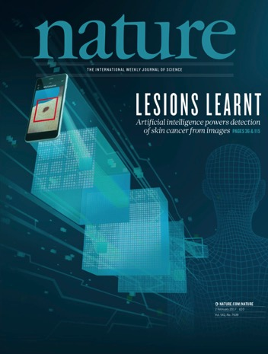
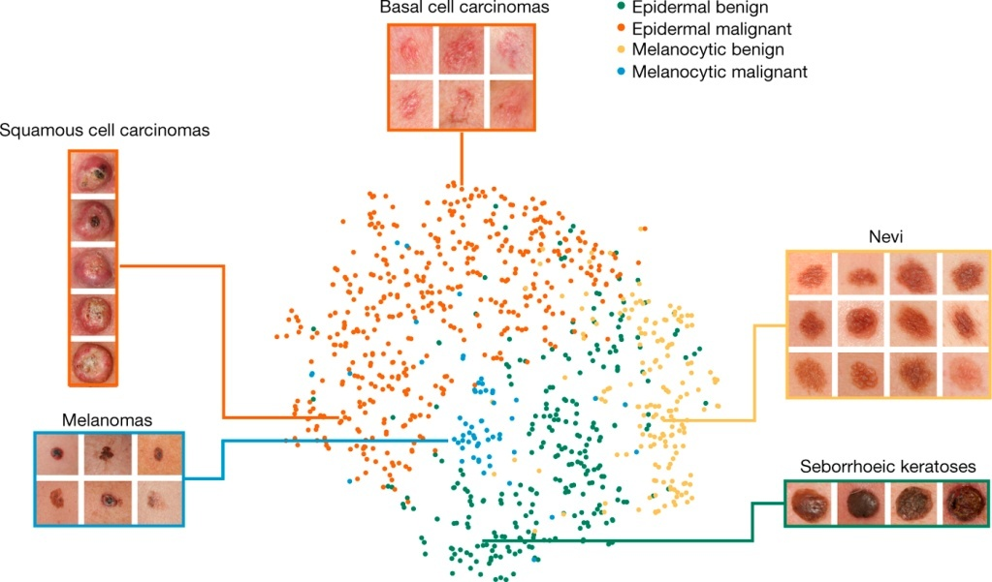
What can deep neural networks do? Medical diagnosis
2017
Plus: Deep learning can predict microsatellite instability directly from histology in gastrointestinal cancer.
Nature Brief Communication, June 2019
The CNN’s representation of four important disease classes of melanoma (skin cancer).
Notes:
In this work, we pretrain a deep neural network at general object recognition, then fine-tune it on a dataset of ~130,000 skin lesion images comprised of over 2000 diseases.
Here we show the CNN’s internal representation of four important disease classes by applying t-SNE, a method for visualizing high-dimensional data, to the last hidden layer representation in the CNN of the biopsy-proven photographic test sets (932 images). Coloured point clouds represent the different disease categories, showing how the algorithm clusters the diseases. Insets show images corresponding to various points. Images reprinted with permission from the Edinburgh Dermofit Library (https://licensing.eri.ed.ac.uk/i/software/dermofit-image-library.html).

Slide 5
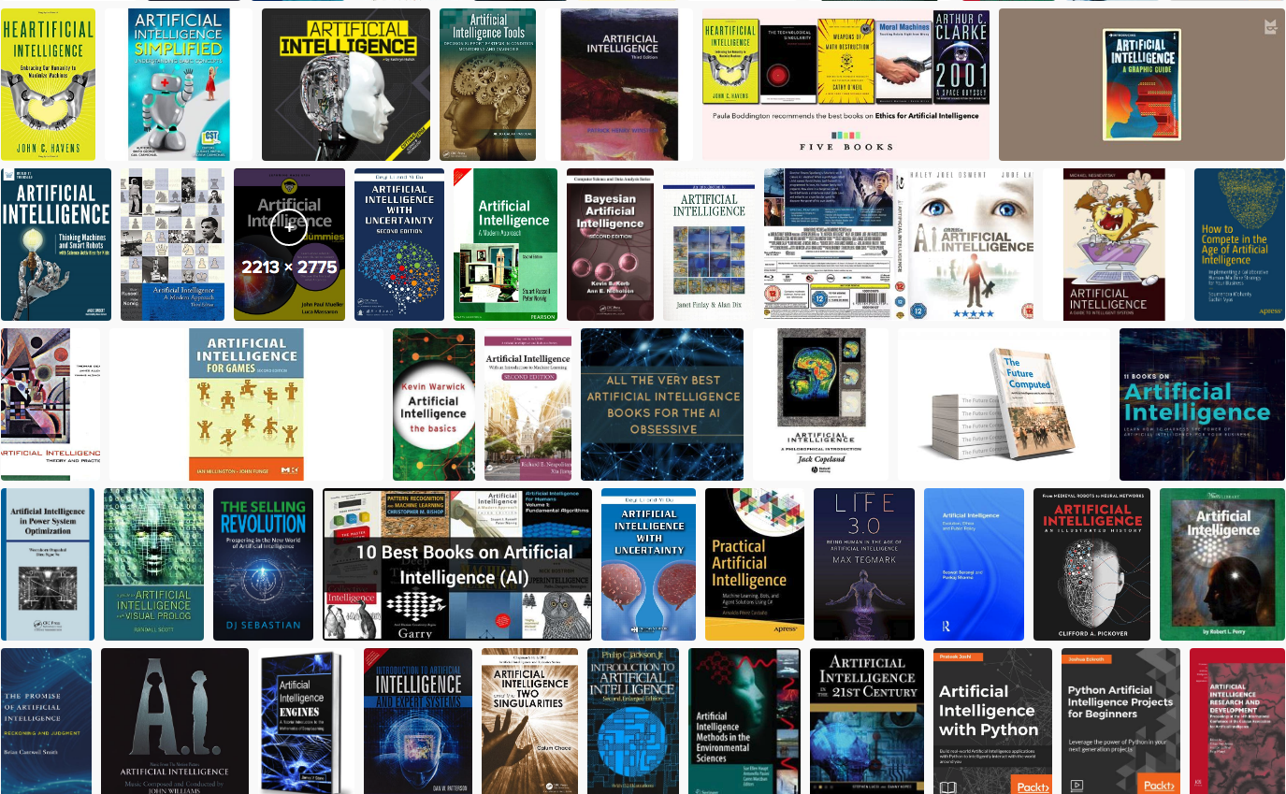
Artificial Intelligence Books

Slide 6
What is a deep learning neural network?

Slide 7
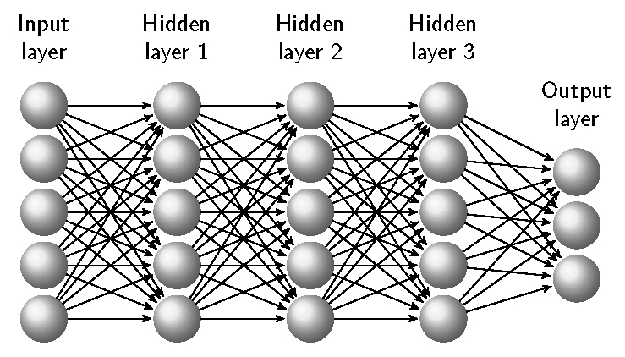
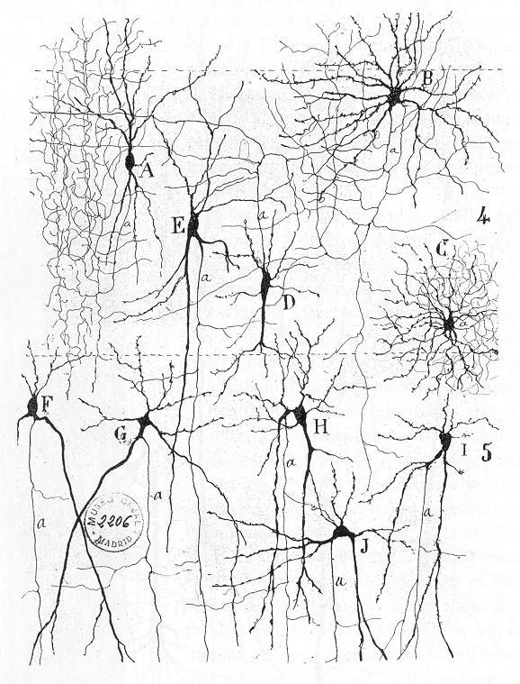
What is a deep learning neural network?
Deep learning network
Cajal’s drawing of neurons, 1900
unit
weight
Notes:
Santiago Ramón y Cajal (Spanish: [sanˈtjaɣo raˈmon i kaˈxal]; 1 May 1852 – 17 October 1934) was a Spanish neuroscientist

Slide 8
Three similarities to human memory
1) Content Addressable. Neural network memories are content addressable, so recall is triggered by an image or a sound. In contrast, a computer memory can be accessed only if the specific location (address) of the required information is known.
2) Generalisation. Neural networks can generalise. Recall can be triggered by an input image that is merely similar to a learned association.
3) Graceful Degradation. If a single weight or unit is destroyed, this does not remove a particular learned association; instead, it degrades all associations to some extent.

Slide 9
AI Before Artificial Neural Networks

Slide 10
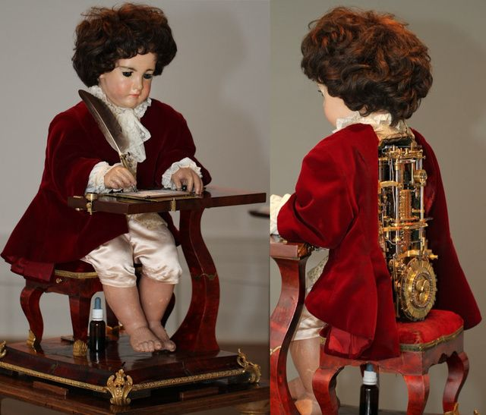
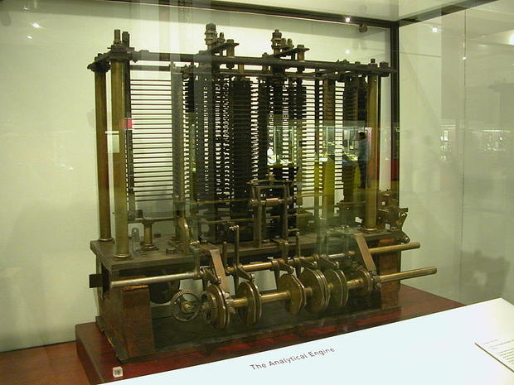
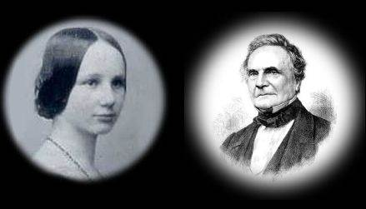
AI Before Artificial Neural Networks (1/2)
Pierre Jaquet-Droz,
The Writer, 1770
Ada Lovelace and Charles Babbage's Analytical Engine, 1842

Slide 11
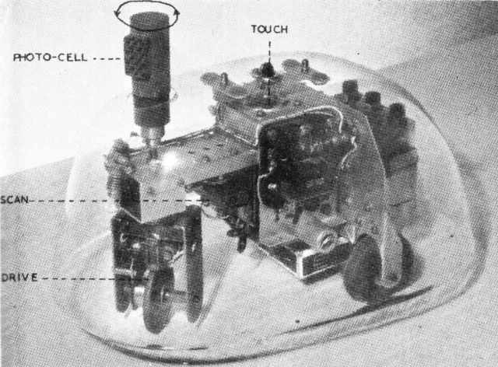
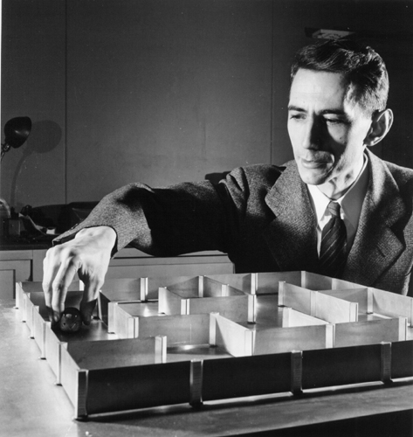
AI Before Artificial Neural Networks (2/2)
Claude Shannon’s
Theseus Mouse, 1950
Gray Walter’s Turtle 1948

Slide 12
History of Artificial Neural Networks

Slide 13
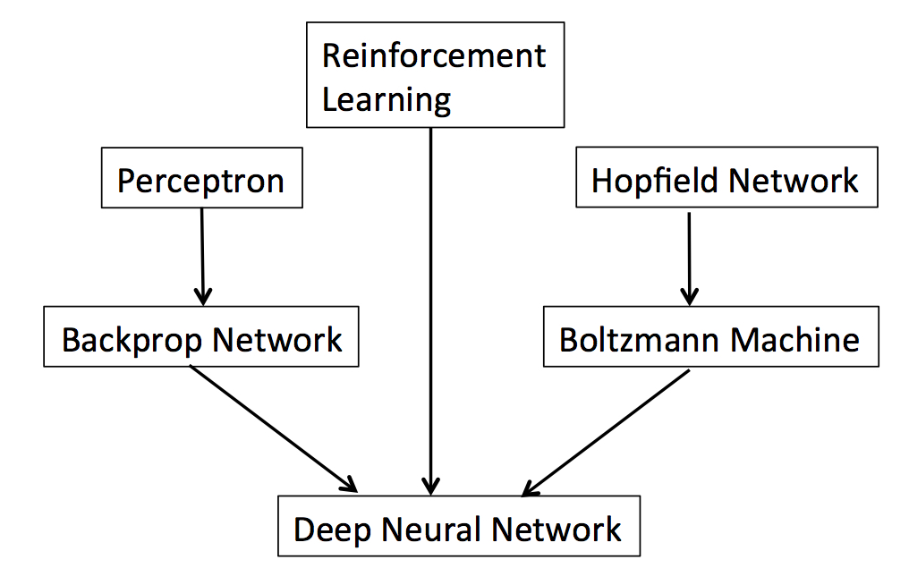
Neural Networks History: Overview
1983-present
1958
1982
1986
1984
2008-present

Slide 14
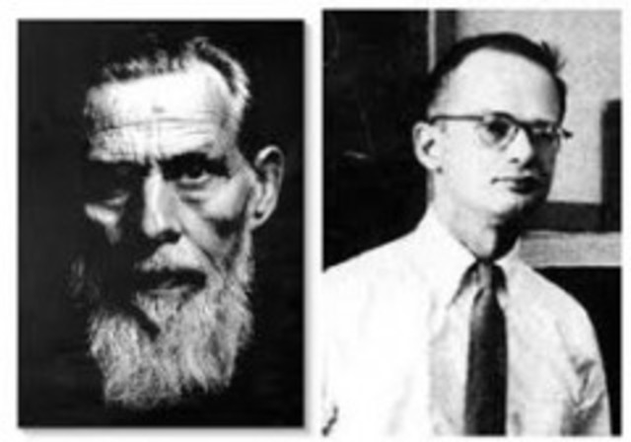
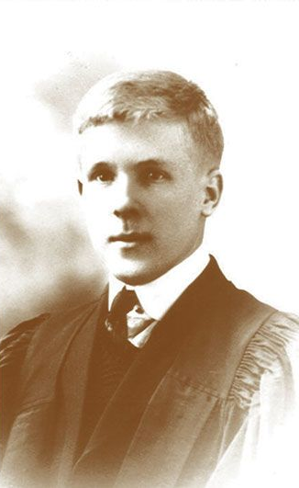
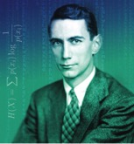
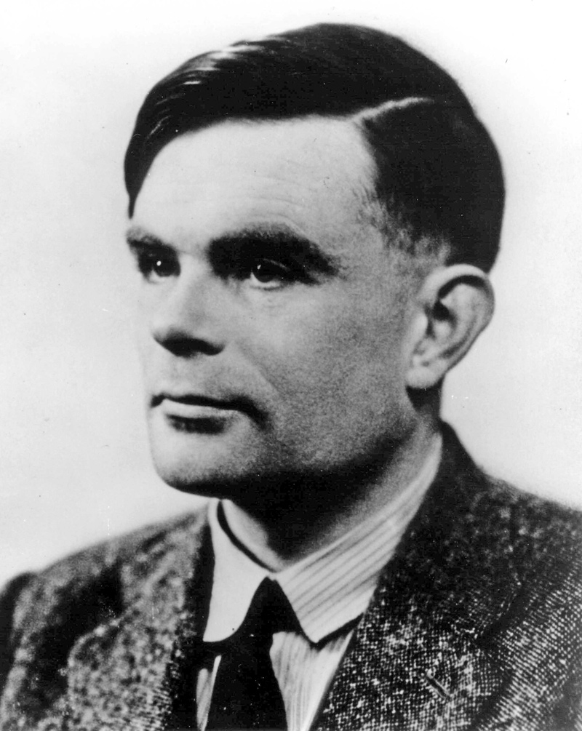
Key Developments: 1/4
1943: McCulloch and Pitts. "A logical
calculus of the ideas immanent in nervous activity”
1949: Donald Hebb.
“The Organization of Behavior”
1949: Claude Shannon.
"Programming a Computer for Playing Chess”.
1950: Alan Turing.
“Computing Machinery and Intelligence”.

Slide 15
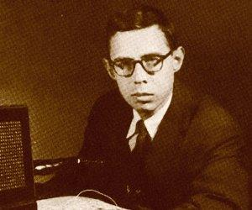
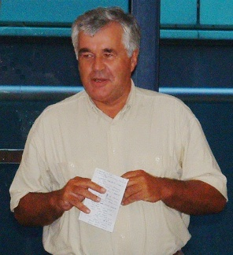
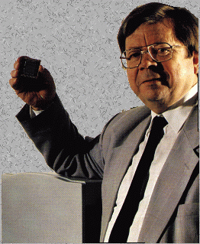
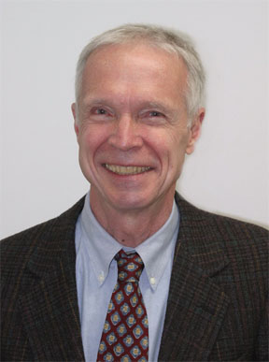
Key Developments: 2/4
1958: Frank Rosenblatt.
“The perceptron: A probabilistic model for information storage and organization in the brain.”
1970: Longuet-Higgins, Willshaw, and Buneman.
“Theories of associative recall”.
1972: T Kohonen.
“Correlation Matrix Memories”.
1982: John Hopfield.
“Neural networks and physical systems with emergent collective computational abilities”.
Notes:
1968: Longuet-Higgins, HC. “The non-local storage of temporal information”
1981: Geoffrey Hinton, “A parallel computation that assigns canonical object-based frames of reference”.

Slide 16
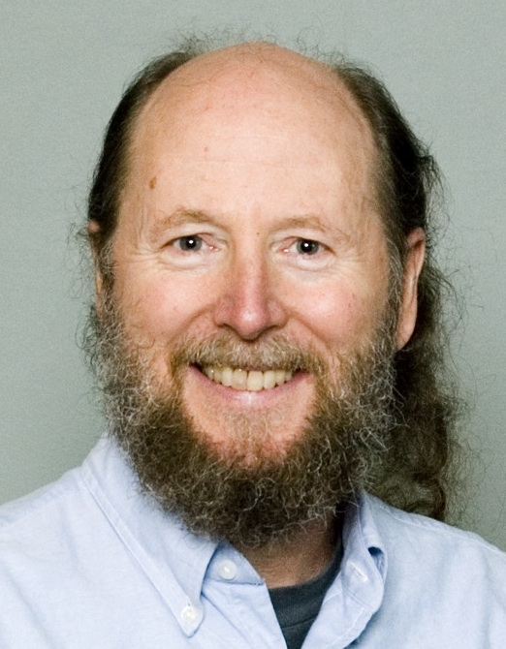
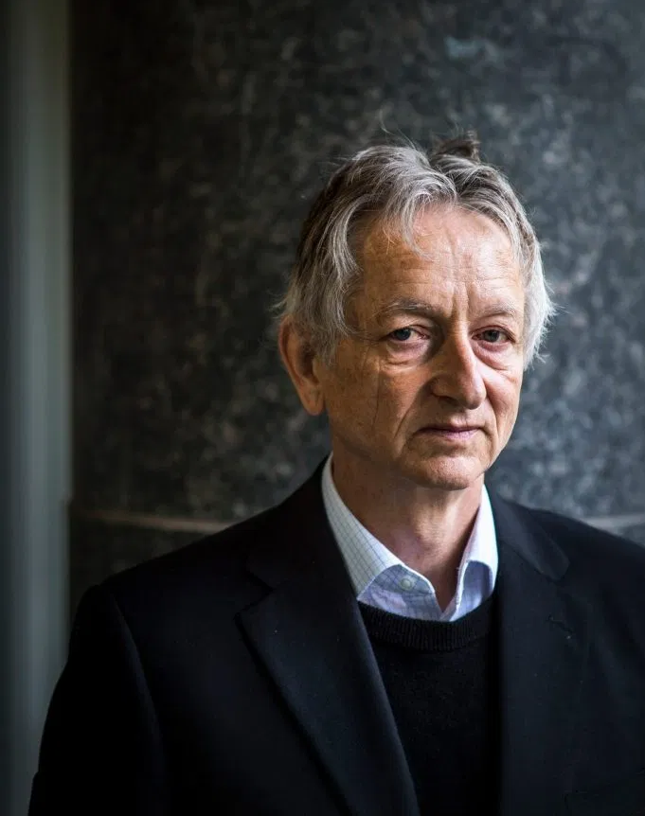
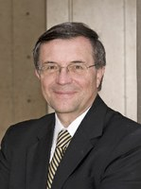
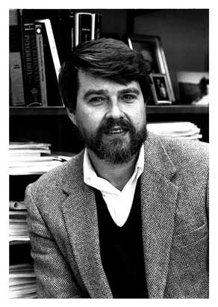
Key Developments: 3/4
1983: Barto, Sutton and Anderson.
“Neuronlike adaptive elements that can solve difficult learning control problems”.
1984: Hinton, Sejnowski and Ackley.
“Boltzmann machines: Constraint satisfaction networks that learn”.
1986: Rumelhart, Hinton and Williams.
“Learning representations by back-propagating errors”.
Notes:
1968: Longuet-Higgins, HC. “The non-local storage of temporal information”

Slide 17
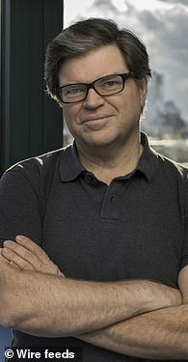
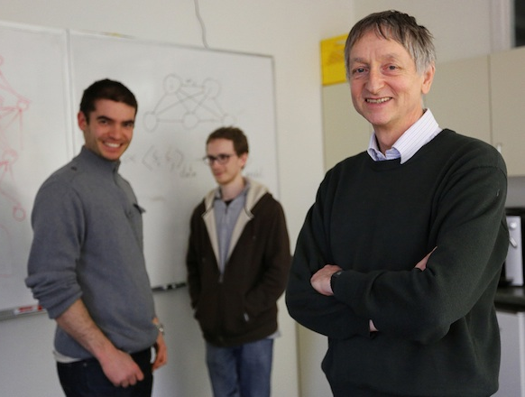
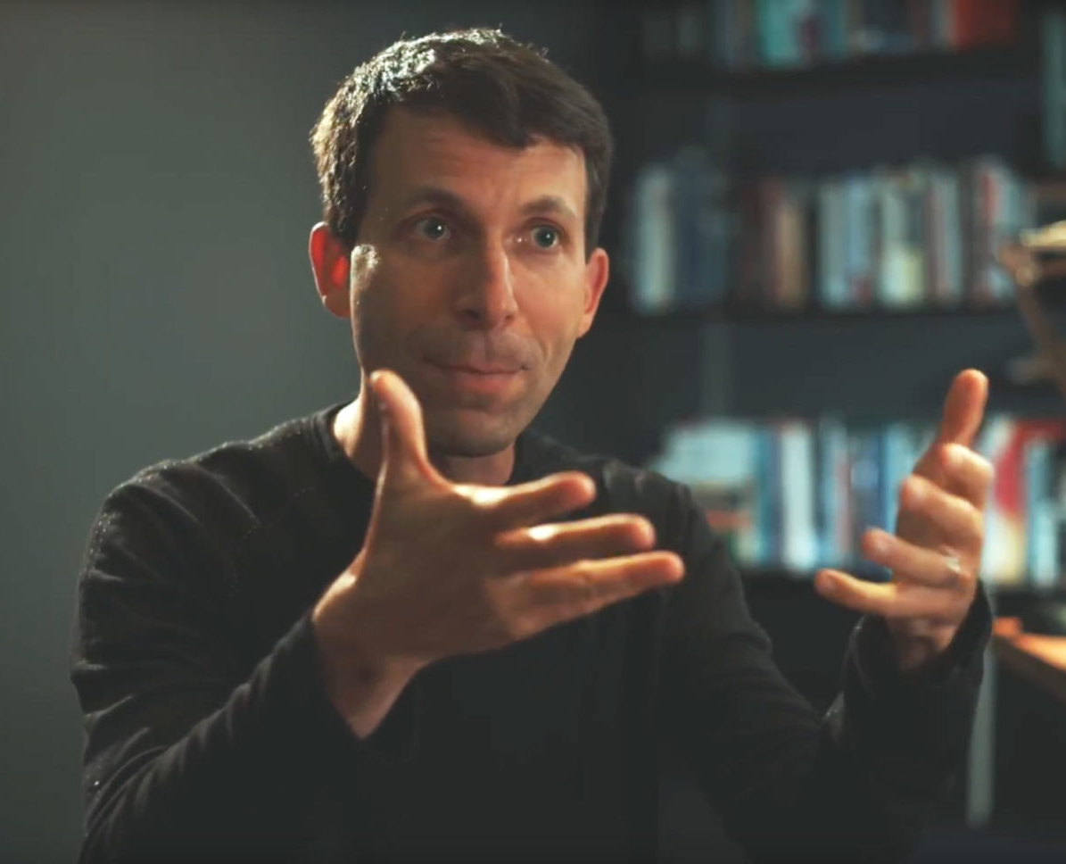
Key Developments: 4/4
1989: LeCun, Boser, Denker, Henderson, Hubbard, and Jackel.
“Backpropagation applied to handwritten ZIP code recognition”.
1995: G Tesauro. (backgammon)
“Temporal difference learning and TD-Gammon”.
2012: Krizhevsky, Sutskever and Hinton. (AlexNet)
“Imagenet classification with deep convolutional neural networks”.
2016: AlphaGo
“Mastering the game of Go with Deep Neural Networks & Tree Search”, Silver, Huang, et al. Nature 2016
defeated Go grandmaster Lee Sedol. (see below)
Notes:
1968: Longuet-Higgins, HC. “The non-local storage of temporal information”

Slide 18
What can deep neural networks do?

Slide 19
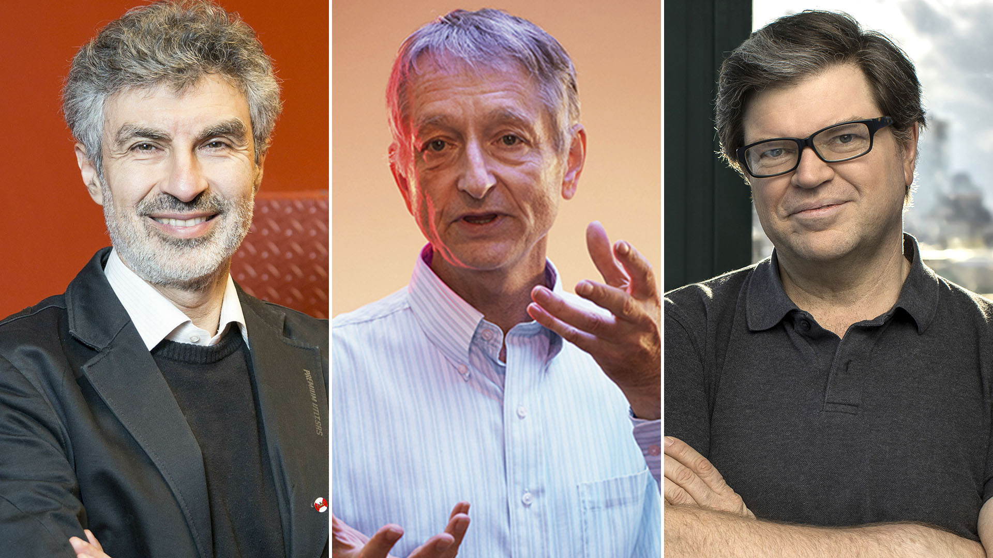
What can deep neural networks do?
Object recognition
Chess etc
Flying
Medical diagnosis

Slide 20
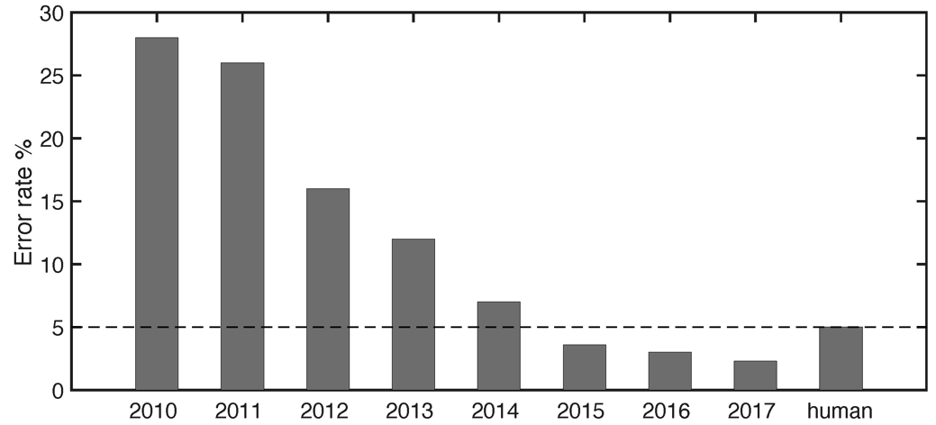
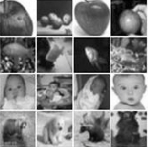
What can deep neural networks do? Classifying Images
The latest competition involves classifying about 1.5 million images into 1,000 object classes.
The percentage error on the annual Large Scale Visual Recognition Challenge (ILSVRC) image classification competition has fallen dramatically since 2010.
Reproduced with permission from Wu and Gu (2015).

Slide 21
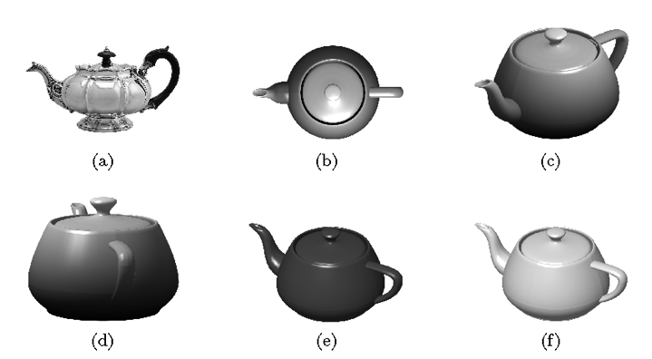
What can deep neural networks do? Why object recognition is hard
Basically, objects can appear at any size/orientation/colour.
Consider a square (black and white) image of 1,000 × 1,000 pixels.
If each pixel can adopt 256 grey-levels then the number of possible images is 256^{1,000,000} (atoms in the universe = 10⁸⁷).
Most of these 256^{1,000,000} possible images look like random noise, and only a tiny fraction depict anything approaching a natural scene — and only a fraction of those depict a teapot.
If a network is to discriminate between teapots and non-teapots then it implicitly must assign a probability to each of the 256^{1,000,000} possible images.

Slide 22
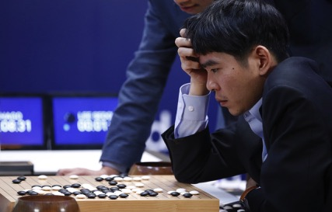
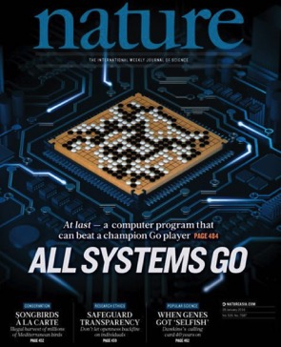
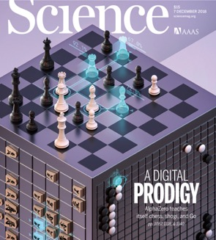
What can deep neural networks do? Go and Chess
2016: AlphaGo defeated Go grandmaster Lee Sedol.
2017: AlphaGo Zero beat AlphaGo.
2018: Alpha for chess, shogi (Japanese chess), and Go, beating a world-champion program in each case.
Notes:
2018 was alpha zero???

Slide 23
What can deep neural networks do? Cycling

Slide 24
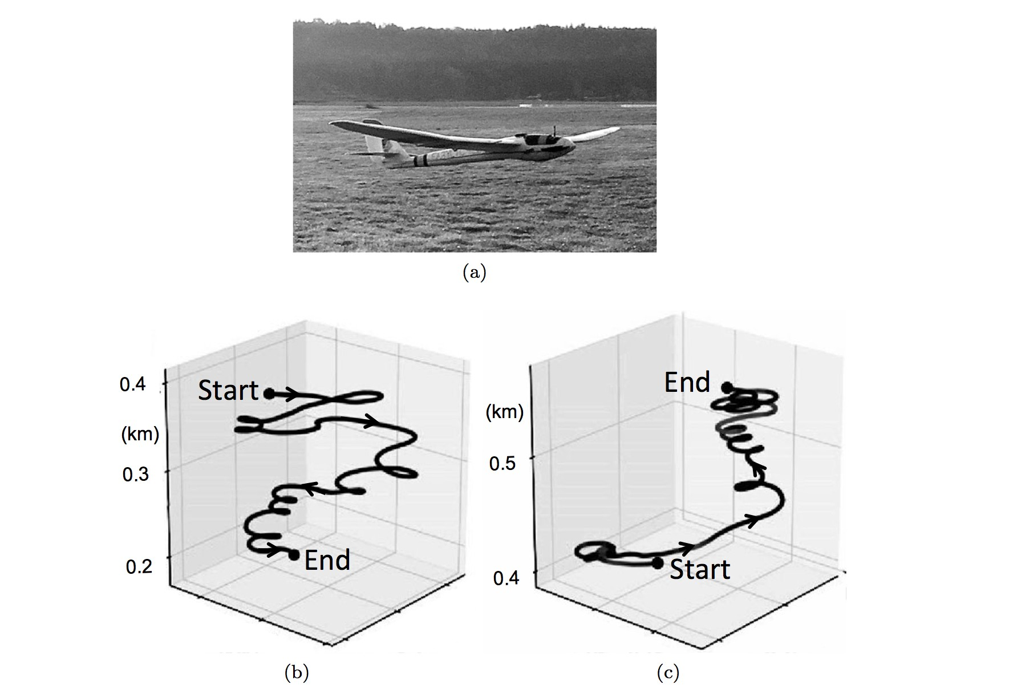
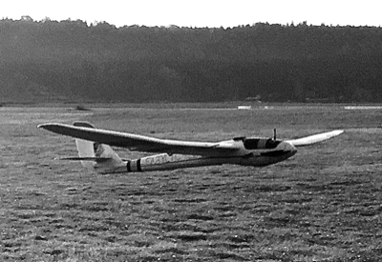
What can deep neural networks do? Flying
Reddy et al 2016/18

Slide 25
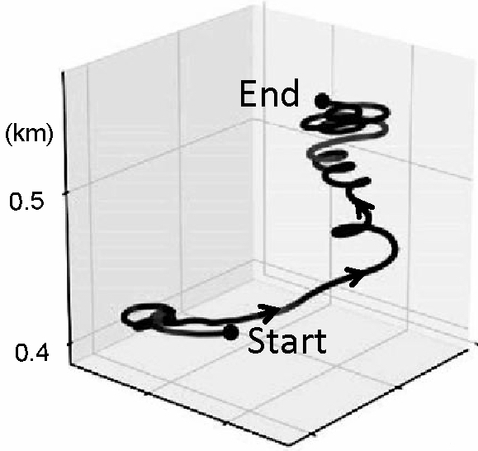
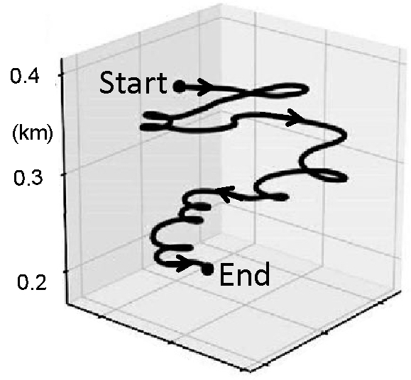
What can deep neural networks do? Flying
After learning
Before learning

Slide 26
What can deep neural networks NOT do?

Slide 27
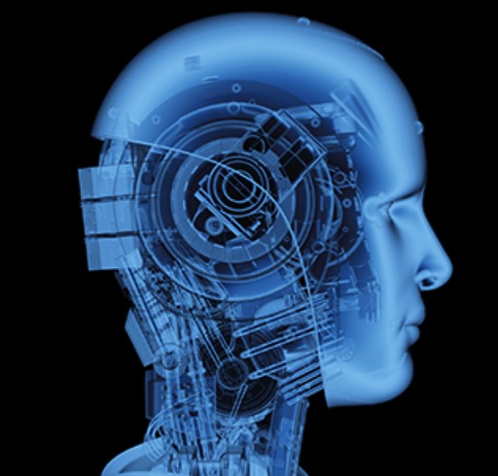
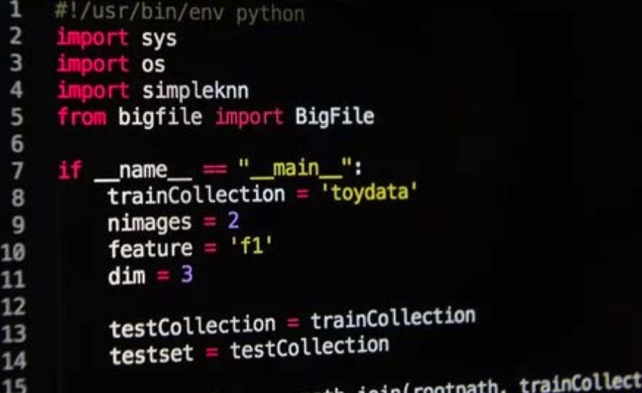
What can deep neural networks NOT do? Artificial Intelligence (yet)
AI in the press
AI in the computer

Slide 28

In Conclusion: Can a machine think?
Before Orville and Wilbur Wright flew the first aeroplane in 1903, skeptics declared that a machine could never fly like a bird. Today, many of us are like those skeptics, doubting that a machine could ever achieve human levels of intelligence.
But birds and brains are physical devices, and that they both must obey the same laws of physics.
In other words, a bird is a flying machine that happens to be made of organic matter, and a brain is a computational machine that happens to be made of neurons.
It therefore seems obvious, and even inevitable, that a machine can fly even if it is not made of organic matter, and that a computational machine can be intelligent even if it is not made of neurons.
Q. Can a machine think?
A. Take a look in the mirror.

Slide 29
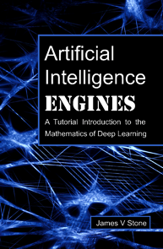
Recommended Resources
Geoffrey Hinton and Yann LeCun, The Turing Lecture 2019: https://www.youtube.com/watch?v=VsnQf7exv5I
Comment: An overview from key researchers.
Nielsen (2015), Neural Networks and Deep Learning is a free online book. http://neuralnetworksanddeeplearning.com/
Comment: A little dated, but still makes a fine starting point.
Stone (2019), Artificial Intelligence Engines: A Tutorial Introduction to Deep Learning.
Comment: !

Slide 30
Thank you

Slide 31
THE END

Slide 32
THE END

Slide 33
THE END

Slide 35
The Turing Day
The workshop will be mostly lectures followed by a lab session.
10:00-11:00 Introduction: Deep Learning and AI: What it is, what it can, and cannot do. JVS
11:00-12:00 Overview: From linear networks to convolutional networks. SJE
12:00-13:00 Lunch
13:00-14:00 Deep Learning using Gradient Descent: What it is, and how it can fail. Backprop and overfittng and vanishing gradients. JVS
14:00-15:00 Reinforcement Learning. LDC
15:15-17:00 Using Python for networks. Lab session with all three instructors.

Slide 36
What is a deep learning neural network?
weight
unit

